Slide 1
Structural Holes Theory

Slide 2
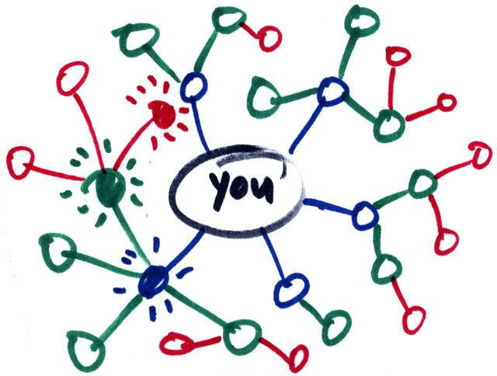
What is social capital?
Social capital:
  Benefits accrued as the result of your connections
    People who are better connected do better
What can you get from your connections?
  Some benefits comes from strong, dense networks:
    Social and emotional support
      Trusting somebody with an intimate secret
    Companionship
      Having somebody to hang out with
    Material support
      knowing where to go in a time of need

Slide 3
What is social capital?
Social capital:
  Benefits accrued as the result of your connections
    People who are better connected do better
What can you get from your connections?
  Some benefits come weakly connected, diverse networks:
    Novel information
      Finding out about things that your close contacts might not know
    New or cutting edge ideas
      Combining different ideas into a new idea
    New people
      Being introduced to people who can help

Slide 4
What is social capital?
What you get from your connections depends on how you are connected to others
  Two arguments:
    Social capital as closure (Coleman 1990)
      Having a core group of intimate friends who also know one another
    Social capital as brokerage (Burt 2005: 4)
      “Advantage created by a person’s location in a structure of relations”
  Which one is the better form of capital?
    Depends on what you want!
Here we will focus on the second:
  Social capital from being a connector (or being connected to people who connect) between different worlds

Slide 5
Structural Holes Theory
People who may know something your close friends don’t know
Strength of Weak Ties is a theory about how you can connect to brokers by developing bridging ties
  It is a theory of social capital as information access
But note that here the powerful person is the broker not you
  She controls the information
What if you want to be the broker in control?
Broker
Bridging tie

Slide 6
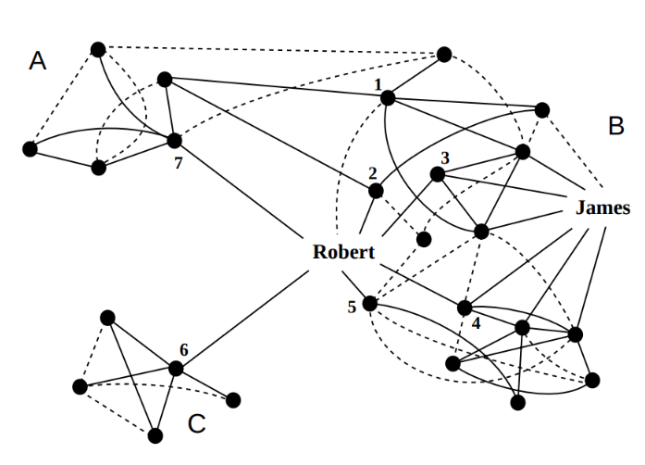
Structural holes theory
Structural Holes is a theory about how to configure your network so that you control the information:
  Others depend on you for access
  You maximize social capital when you occupy a position “in between” others:
    Violations of g-transitivity create “holes” in social structure
  Who has the most social capital?
    James or Robert?

Slide 7
Structural holes theory
Structural holes in networks provide two kinds of benefits:
  Passive exposure effect:
    You get to know what other people know (a la Granovetter)
  Active control effect (Burt 1995):
    You decide whether some people know some things or not
    You shape the way other people perceive others
    You can play people against one another

Slide 8
Structural holes theory
Structural holes in networks provide two kinds of benefits:
  Passive exposure effect:
    You get to know what other people know (a la Granovetter)
  Active control effect (Burt 1995):
    You are less bound by the norms and expectations of any one group
    You are free to move across the social structure
      Be different things to different people

Slide 9
Structural holes theory
The opposite of having structural holes is what Burt calls Network Constraint
  In a high constraint network:
    Your contacts are connected to one another
    You are subject to the strong expectations of a single group
    You depend on others for information access

Slide 10
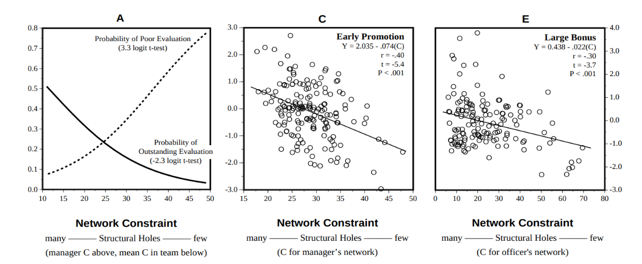
Structural holes theory
Evidence for structural holes argument (Burt 2005):
  In corporate settings people who have networks rich in structural holes (low constraint):
    Receive higher salaries
    Get promoted faster
    Receive better performance evaluations

Slide 11
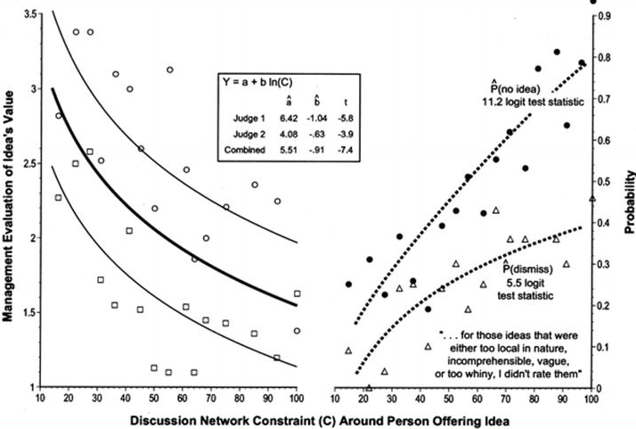
Structural holes theory
Why do people located in between structural holes do better?
  They have better ideas (Burt 2005)
Why do they have better ideas?
  They can combine elements from different sources to create novel combinations

Slide 12
Diagnosing your ego network
Theories of social capital as brokerage recommend that ego-network diversity is better than homogeneity
  Kinds of diversity in ego-networks:
    Range (Size, Degree)
    Demographic diversity of alters
    Homophily (low)
    Average tie strength
  Measures of brokerage:
    Size
    Clustering Coefficient
    Effective Size

Slide 13
Types of Brokerage in Networks

Slide 14
Types of Brokerage in Networks
In Social Network Analysis brokerage refers to the capacity of certain actors to intermediate between others
  Thus brokerage is a relationship between three parties
Network analysts distinguish between five types of brokerage depending on the groups that the broker and the two other actors belong to

Slide 15
Types of Brokerage in Networks
B
A
C
Coordinator
In Social Network Analysis brokerage refers to the capacity of certain actors to intermediate between others
  Thus brokerage is a relationship between three parties
Network analysts distinguish between five types of brokerage depending on the groups that the broker and the two other actors belong to
A local broker or coordinator (B) is an actor that intermediates between members of the same group (A, C) while they also belong to the group
  All three parties belong to the same group

Slide 16
Types of Brokerage in Networks
B
A
C
Coordinator
In Social Network Analysis brokerage refers to the capacity of certain actors to intermediate between others
  Thus brokerage is a relationship between three parties
Network analysts distinguish between five types of brokerage depending on the groups that the broker and the two other actors belong to
A Cosmopolitan or Itinerant broker (B) intermediates between members of the same group (A, C) but belongs to a different group
B
A
C
Itinerant

Slide 17
Types of Brokerage in Networks
B
A
C
Coordinator
In Social Network Analysis brokerage refers to the capacity of certain actors to intermediate between others
  Thus brokerage is a relationship between three parties
Network analysts distinguish between five types of brokerage depending on the groups that the broker and the two other actors belong to
A Gatekeeper (B) deals with an outsider to the group (A) and decides whether to grant them access to a member of their same group (C)
B
A
C
Itinerant
B
A
C
Gatekeeper

Slide 18
Types of Brokerage in Networks
B
A
C
Coordinator
In Social Network Analysis brokerage refers to the capacity of certain actors to intermediate between others
  Thus brokerage is a relationship between three parties
Network analysts distinguish between five types of brokerage depending on the groups that the broker and the two other actors belong to
A Representative (B) actively contacts an outsider to the group (C) on behalf of a fellow in-group member (A)
B
A
C
Itinerant
B
A
C
Gatekeeper
B
A
C
Representative

Slide 19
Types of Brokerage in Networks
B
A
C
Coordinator
In Social Network Analysis brokerage refers to the capacity of certain actors to intermediate between others
  Thus brokerage is a relationship between three parties
Network analysts distinguish between five types of brokerage depending on the groups that the broker and the two other actors belong to
A Liason (B) is an outsider who intermediates between members of different groups (A, C)
B
A
C
Itinerant
B
A
C
Gatekeeper
B
A
C
Representative
B
Gould, R. V., & Fernandez, R. M. (1989). Structures of mediation: A formal approach to brokerage in transaction networks. Sociological Methodology, 89-126.
A
C
Liason

Slide 20
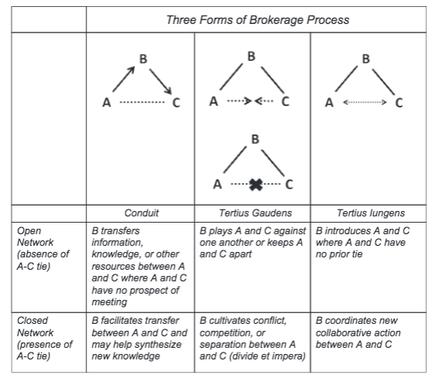
Types of Brokerage in Networks
Brokerage is not just a structural configuration it is also a process
From the process perspective there are three types of brokerage behavior:
  Broker as conduit
    Information/resource transfer
  Broker as divider (Tertius Gaudens)
    The third who benefits (divide and conquer)
  Broker as uniter (Tertius Lungens)
    The third who joins
Obstfeld, D., Borgatti, S. P., & Davis, J. (2014). Brokerage as a process: Decoupling third party action from social network structure. In Contemporary Perspectives on Organizational Social Networks (pp. 135-159). Emerald Group Publishing Limited.

Slide 21
Diversity Bandwidth-Tradeoff Theory

Slide 22
Diversity-bandwidth tradeoff
Original Granovetter argument conceives of the properties of ties (e.g., strength) in static terms
  Yet information transmission/access are events that happen in time
In original Strength of Weak Ties argument:
  Weak ties: Novel information
  Strong ties: Old/redundant information

Slide 23
High
Network Clustering
Low
Clustered Network of Strong, High-Bandwidth Ties
Unclustered Network of Weak, Low-Bandwidth Ties
Channel Bandwidth
High
Low

Slide 24
Diversity-bandwidth tradeoff
When taking into account temporal flow:
  “Weak” ties: Information transmission at slower rates (less frequency)
  “Strong” ties: Information transmission at higher rates (more frequency)
When seeking information via social networks
  There is a tradeoff between novelty/diversity of information and tie “bandwidth”

Slide 25
Diversity-bandwidth tradeoff
What about information complexity?
  Low bandwidth ties: Novel but “simple” information
    Who’s hiring? What’s the best messaging app?
  But what about novel but complex information?
    How to do network analysis in R
  In that case higher bandwidth ties are better!

Slide 26
Diversity-bandwidth tradeoff
The strength of high bandwidth ties:
  More trust, intimacy, and cooperativeness
  Better memory of who knows what
  More effective at transferring complex, interdependent information
  Creating new knowledge (e.g., bringing together rather than keeping apart)
  Commonality of interests and experience (homophily)

Slide 27
Diversity-bandwidth tradeoff
In thinking about preferences between low and high bandwidth ties we must take into account properties of the information environment
  Who knows what?
  At what frequency is knowledge transmitted?
Low bandwidth works better when contacts are diverse in information
1, 2, 3, 4
1, 2, 3, 4
5, 6, 7, 8
1, 2, 3, 4

Slide 28
Diversity-bandwidth tradeoff
1, 2, 3, 4
1, 2, 3, 4
This is better!
5, 6, 7, 8
1, 2, 3, 4
When your contacts have diverse pools of information (different people you know different things)
  Weak low bandwidth ties are better

Slide 29
Diversity-bandwidth tradeoff
1, 2, 3, 4
1, 2, 3, 4
This is redundant!
5, 6, 7, 8
1, 2, 3, 4
When your contacts do not have diverse pools of information (the people you know all know the same thing because they talk to one another)
  Strong, high-bandwidth ties just give you the same information

Slide 30
Diversity-bandwidth tradeoff
In thinking about preferences between low and high bandwidth ties we have to consider properties of the information environment
  Who knows what?
  At what frequency is knowledge transmitted?
1, 2, 3, 4
1, 2, 3, 4
1, 2, 3, 4
5, 6, 7, 8
1, 2, 7, 8
1, 2, 3, 4

Slide 31
Diversity-bandwidth tradeoff
Low bandwidth works better when contacts are diverse in information
  Low bandwidth ties lose their advantage even when connecting ego to contacts with more homogeneous information, even if there is partial overlap of information across contacts
No Information Overlap
Some Information Overlap
Total Information Overlap
1, 2, 3, 4
1, 2, 3, 4
1, 2, 3, 4
5, 6, 7, 8
1, 2, 7, 8
1, 2, 3, 4
Low bandwidth ties are good here!
Low bandwidth ties not as good...
Low bandwidth ties are worse here!

Slide 32
Diversity-bandwidth tradeoff
1, 2, 3, 4
1, 2, 3, 4
1, 2, 7, 8
1, 2, 7, 8
When your contacts do not have diverse pools of information (the people you know all know the same thing because they talk to one another)
  Strong, high-bandwidth ties give faster access to more complex information

Slide 33
Diversity-bandwidth tradeoff
1, 2, 3, 4
1, 2, 3, 4
This is better!
1, 2, 7, 8
1, 2, 7, 8
When your contacts do not have diverse pools of information (the people you know all know the same thing because they talk to one another)
  Strong, high-bandwidth ties give faster access to more complex information

